Slide 1
Unit 2 Assignment The VBA of Wall Street
Kim Powers
10/15/2018

Slide 2
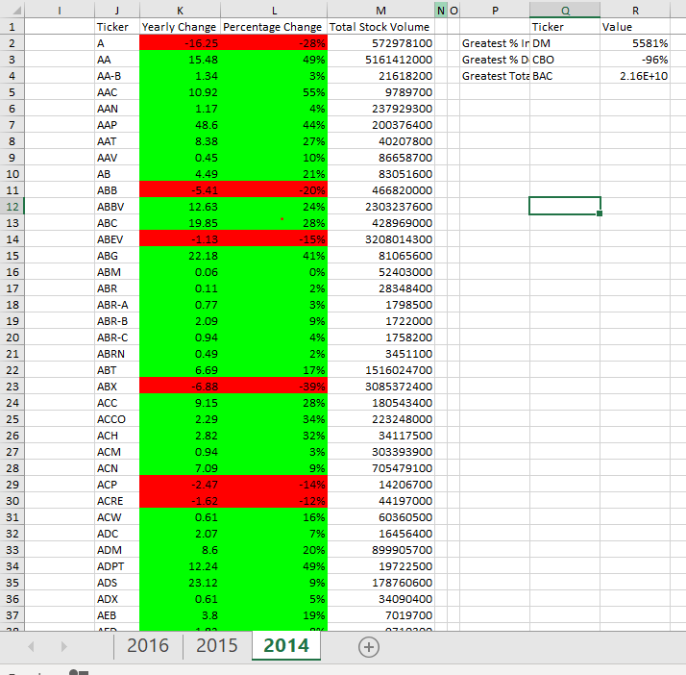
2014

Slide 3
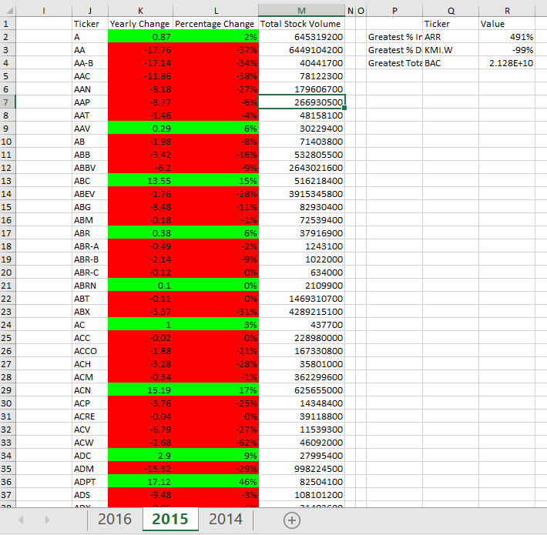
2015

Slide 4
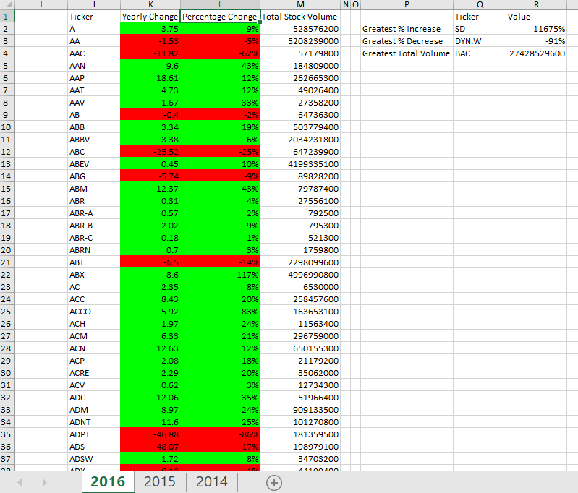
2016

